Slide 1
Ch. 19 Campaigns
Topic 5.10-5.11

Slide 2
What is this?

Slide 3
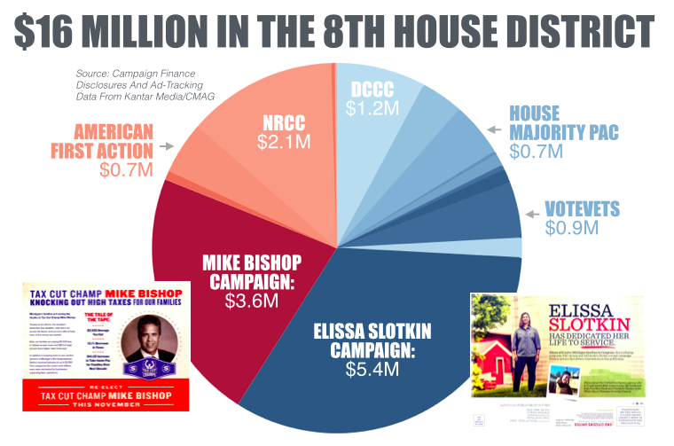
I. Modern Campaigns
Campaign organization
Candidates committee
Party organizations
Outside groups
fundraising

Slide 4
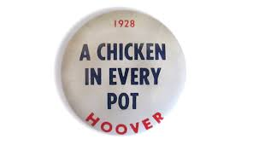
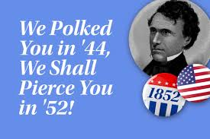
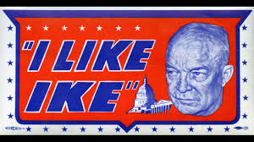
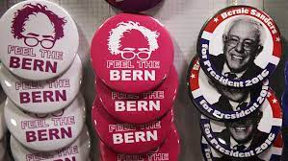
What are these?

Slide 5
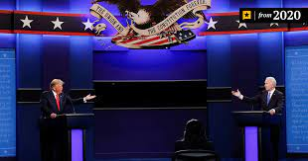
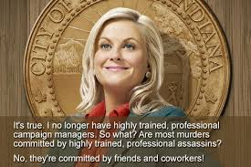
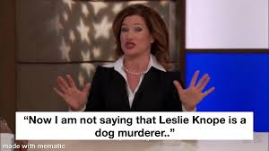
I. Modern Campaigns
B. Campaign strategies
Professional consultants
Showcasing the candidate: defining the opponent, debates, television appearances
Social media

Slide 6
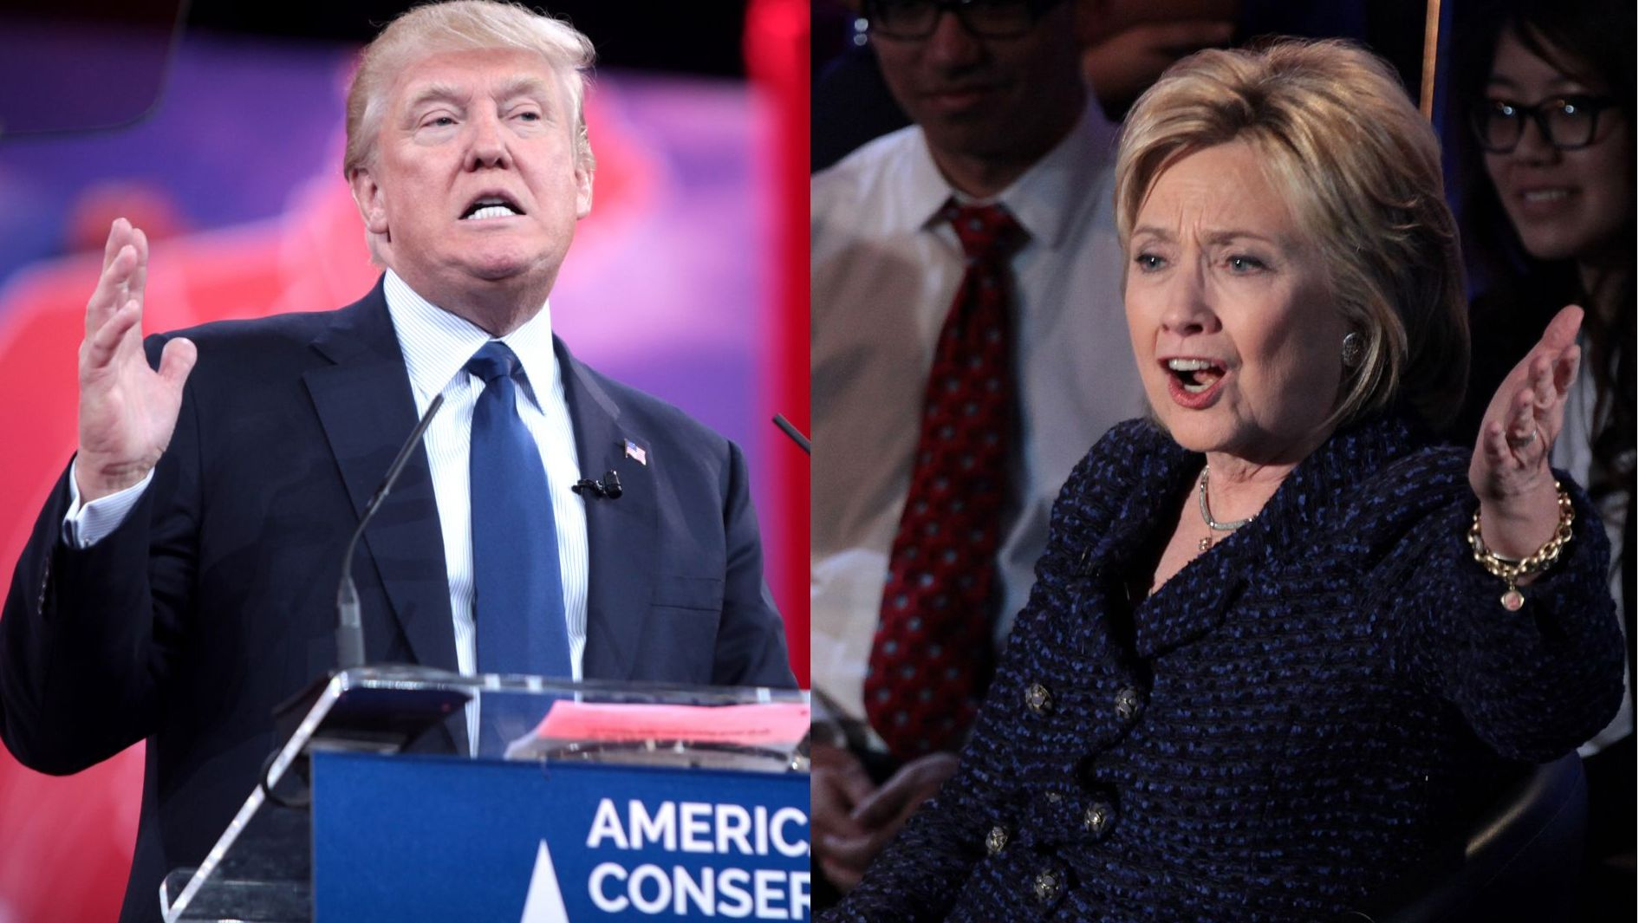
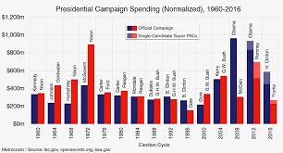
I. Modern Campaigns
C. 2016 presidential campaign
The general election campaign
An ugly campaign
The vote
https://www.nbcnews.com/nightly-news/video/memorable-moments-of-the-2016-presidential-campaign-803193411668

Slide 8
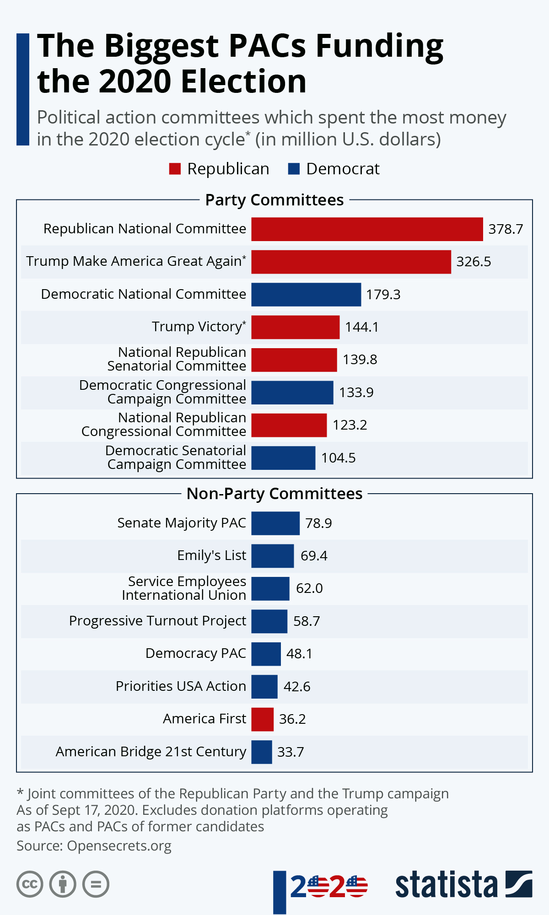

Slide 9
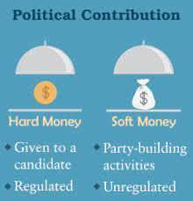
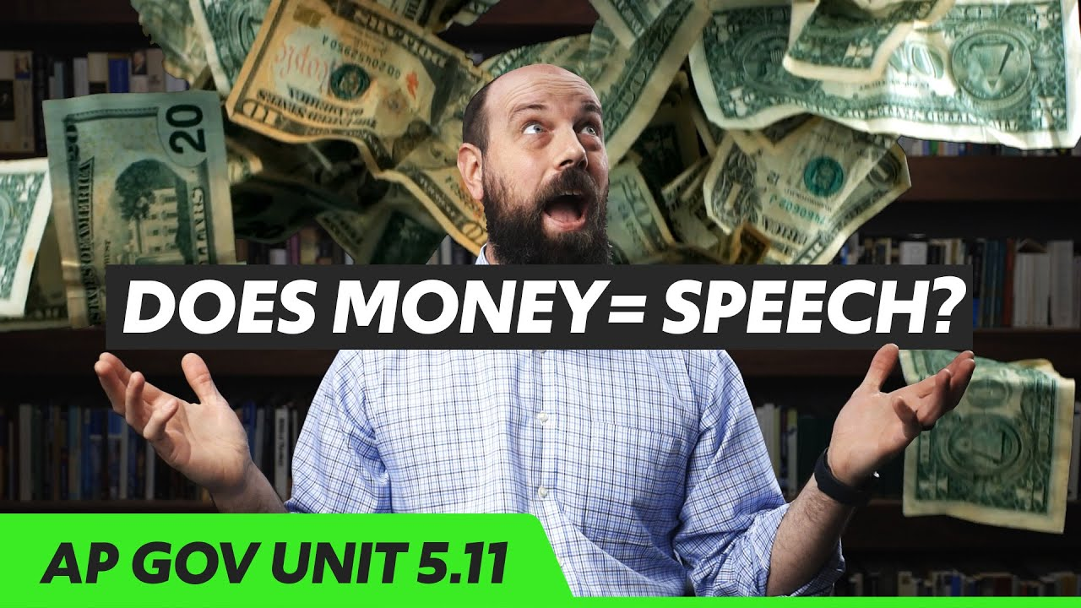
II. Campaign Finance
Federal legislation
the federal election commission (FEC): hard money v. soft money
Bipartisan campaign reform act
Citizens United v. FEC: dark money
Types of PAC’s
Connected
Non connected
Leadership
Super PAC’s
https://youtu.be/Ylomy1Aw9Hk

