Slide 1
Public Opinion
Topic 4.5-4.6

Slide 2
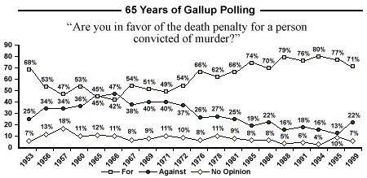
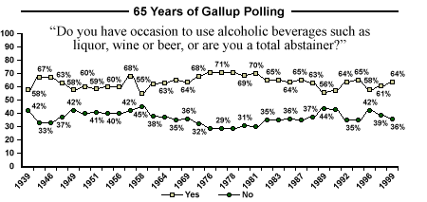
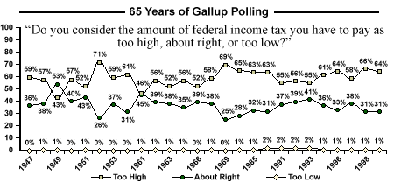
What is a poll?

Slide 3
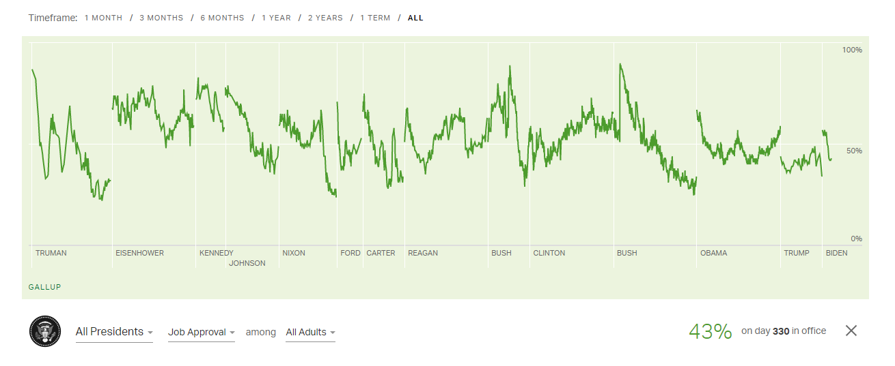
I. Measuring public opinion
What are the elements of a scientific poll and how do those elements impact elections and policy?
Measures
Types of polls
Public opinion polls
Benchmark polls
Bushfire polls
Tracking polls
Entrance/ exit polls
Presidential approval/ ratings
Focus groups

Slide 4
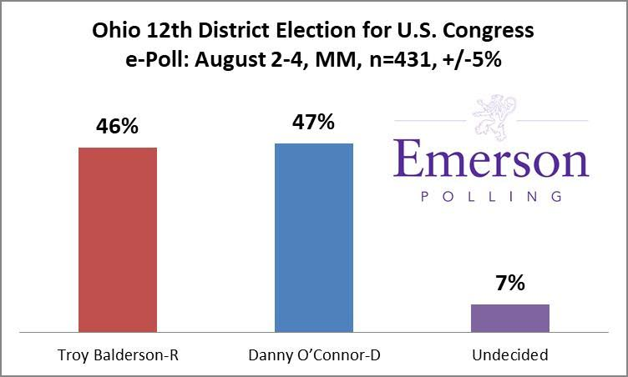
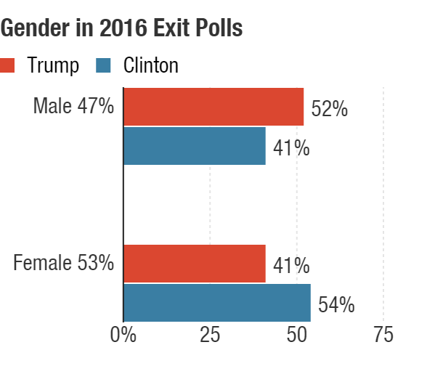
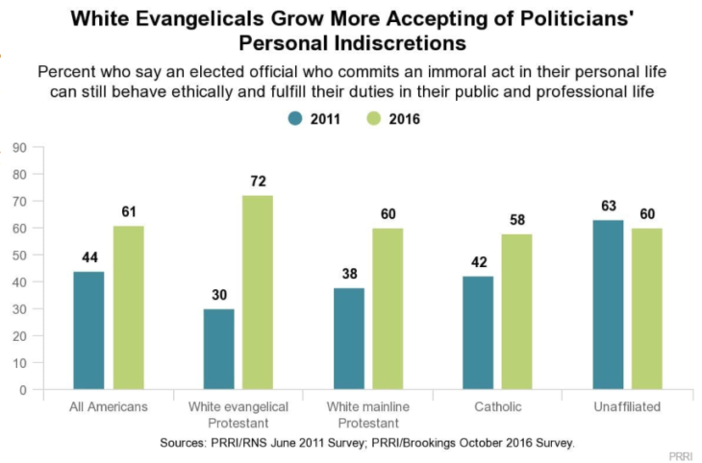
Tracking poll

Slide 5
What's wrong with this picture?

Slide 6
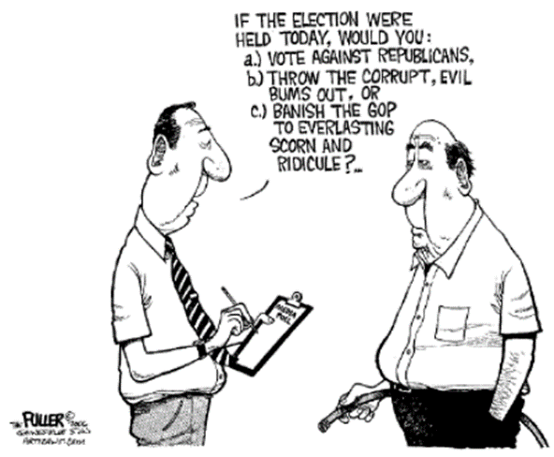
I. Measuring public opinion
B. Methodology
1. questions
- samples, Universe
- random sample
- random digit dialing
- weighting or stratification
2.sampling error/ margin of error
- non-attitudes
- human bias
- push polling

Slide 7
What's wrong with this poll?

Slide 8
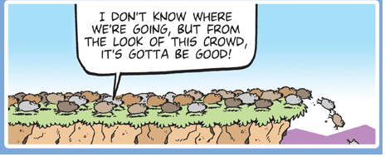
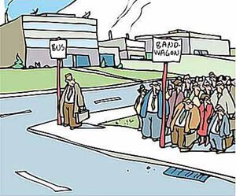
II. Evaluating public opinion data
How can you determine the quality and credibility of claims based on public opinion data?
Claims, Credibility, and public opinion data
Public opinion and political influence
Bandwagon effect
Influence on policy debate
Reliability and veracity of public opinion data
Social desirability/ Bradley effect
Undecideds breaking late
- Non-response bias
Opinions in social media
Biased pollsters and data V. fact

Slide 9
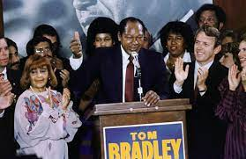
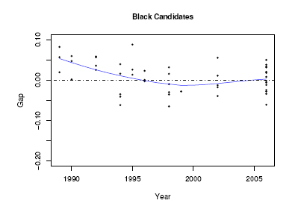

Slide 10
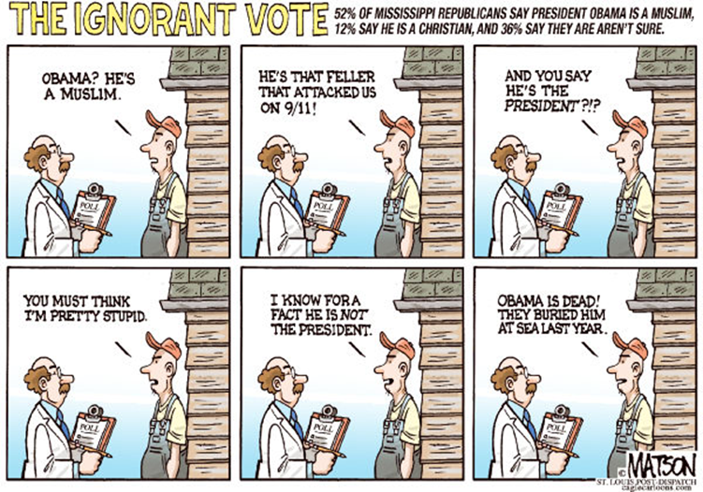

Slide 11
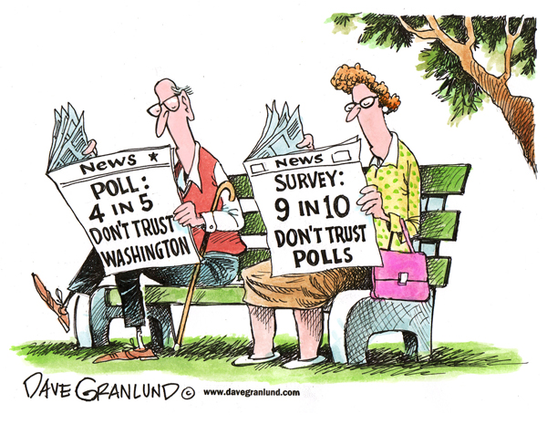

Slide 12
Is there any hope for polls?

