Slide 1
Congress
Topic 2.1-2.3

Slide 2
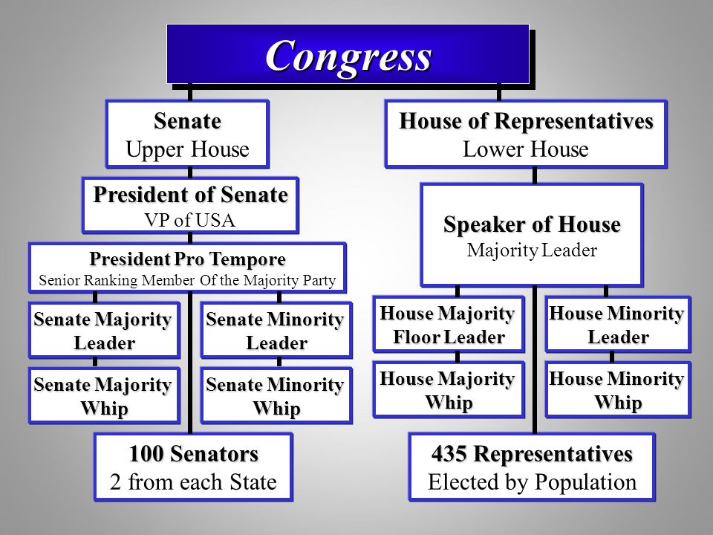
What should we learn from this diagram?

Slide 3
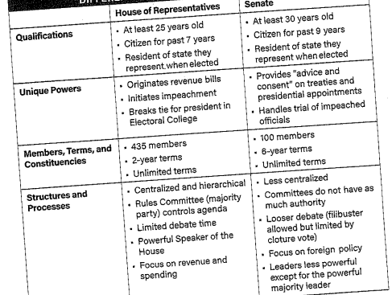
I. The senate and the house of representatives
Describe the structures, powers, and functions of each house of congress.
Structure of Congress
Article I
Bicameral
Senate V. House of Representatives
17th amendment
Size and term length
Caucuses

Slide 4
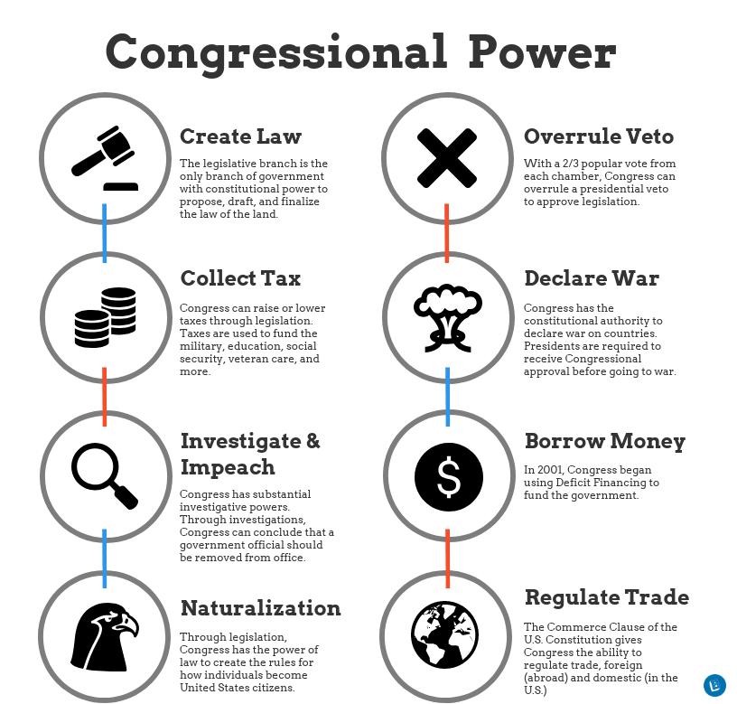
I. The senate and the house of representatives
B. Powers of congress- enumerated powers
Power of the Purse
Regulating commerce
Foreign and military affairs- war powers act
Implied powers- necessary and proper clause
C. Differing powers
- Advice and Consent

Slide 5
What does this tell you about the legislative process?

Slide 6
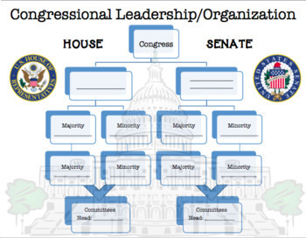
II. Structures, powers and functions of congress
Explain how the structure, powers, and functions of both houses affect the policy making process.
Policy making structures and processes
Leadership
House leaders
Whips
President of the Senate
President Pro tempora
Create a version of the chart in your notebook and fill it out

Slide 8
II. Structures, powers and functions of congress
B. Committees: Standing, Joint, Select, Conference
C. House: Rules and committees
Why are they more important? Germane
Rules Committee, Committee of the whole, Discharge petition
D. Senate: Rules and procedures
A. looser, Filibuster, unanimous consent, hold, Cloture rule
B. Foreign policy

Slide 9
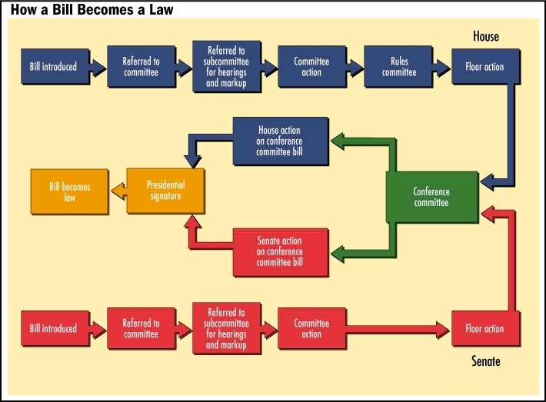
II. Structures, powers and functions of congress
E. Legislative process
1. introduction- sponsor
2. Committee
3. voting
- sponsor, omnibus bill,
pork-barrel spending
F. Generating a budget
1. Sources of revenue
income tax, corporate tax, tariffs and excise tax,
social insurance tax
2.Mandatory spending
3. discretionary spending

Slide 10
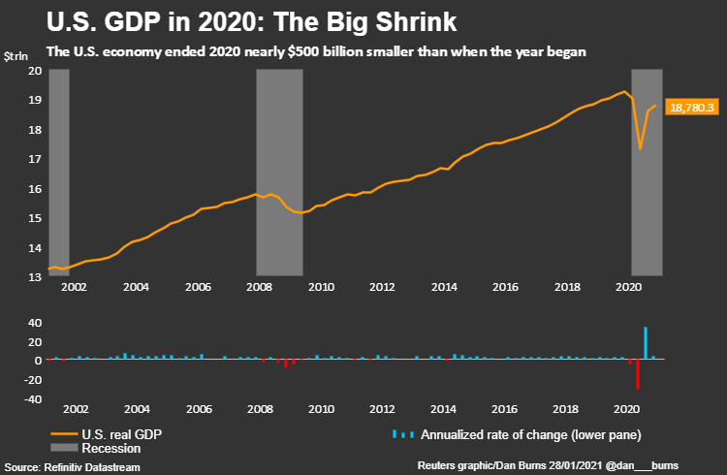

Slide 11
What does this tell us?

Slide 12
III. Congressional behavior
Explain how congressional behavior is influenced by elections processes, partisanship, and divided government.
Influences on Congress:
Partisanship and polarization
Voting models- Delegate model, trustee model, politico model
Redistricting- Baker V. Carr
Gerrymandering- Swing districts, Racial Gerrymandering, Shaw V. Reno
Divided government- Lame Duck President
Public image

Slide 13
