Slide 1
Federalism
Topic 1.7-1.9

Slide 2
What are some examples of State powers, What are some Federal powers?

Slide 3
I. Relationship between the States and Federal Government
Explain how societal needs affect the constitutional allocation of power between national and state government.
A. provisions defining federalism
Article VI: Supremacy Clause
Article IV: Full faith and credit
B. Exclusive powers:
National: war, interstate/ national commerce
State: schools, health and safety, internal division
C. Concurrent powers: taxes and law enforcement

Slide 4
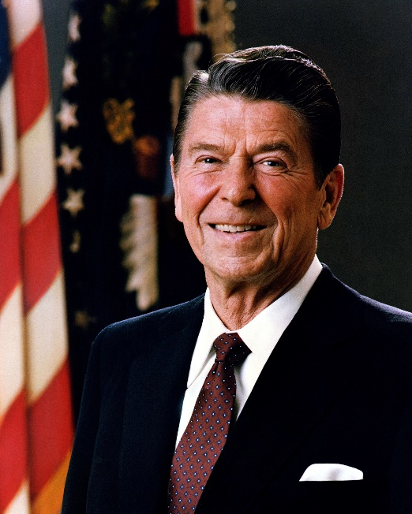
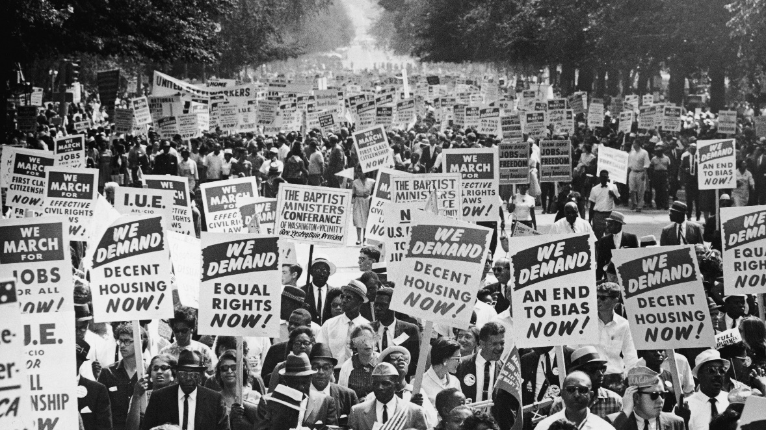
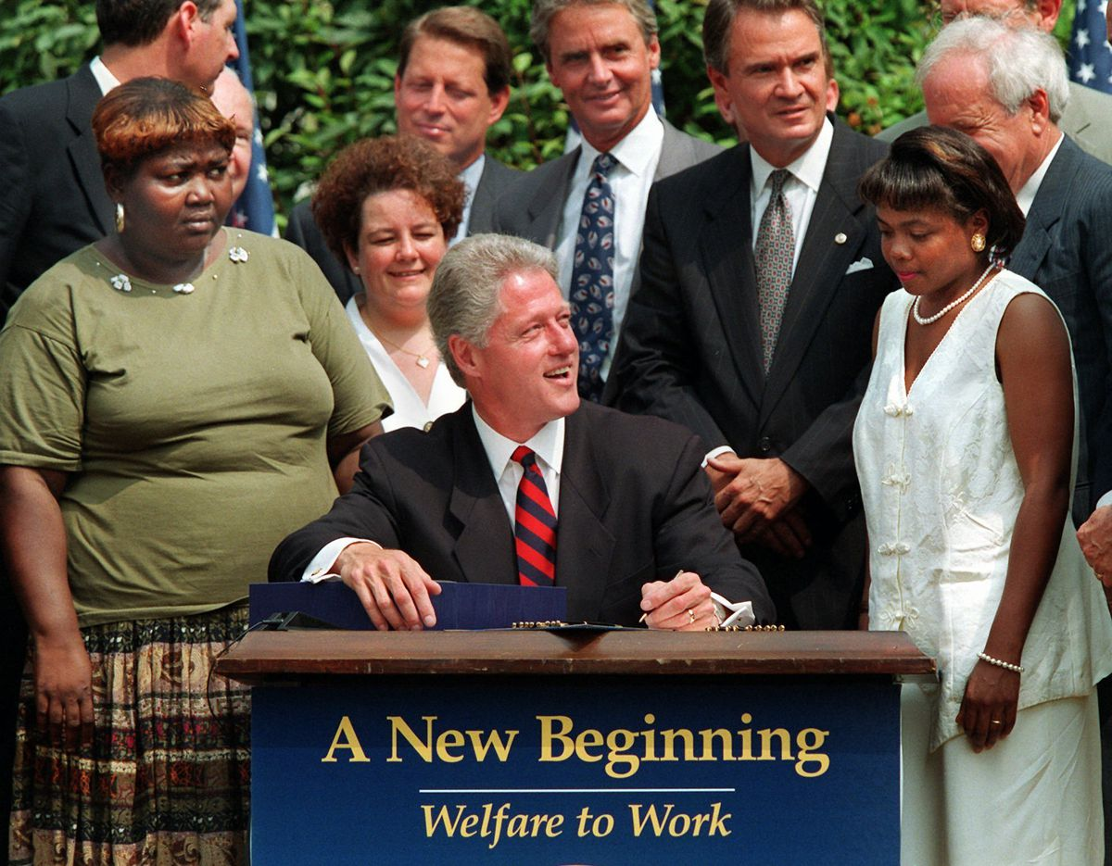
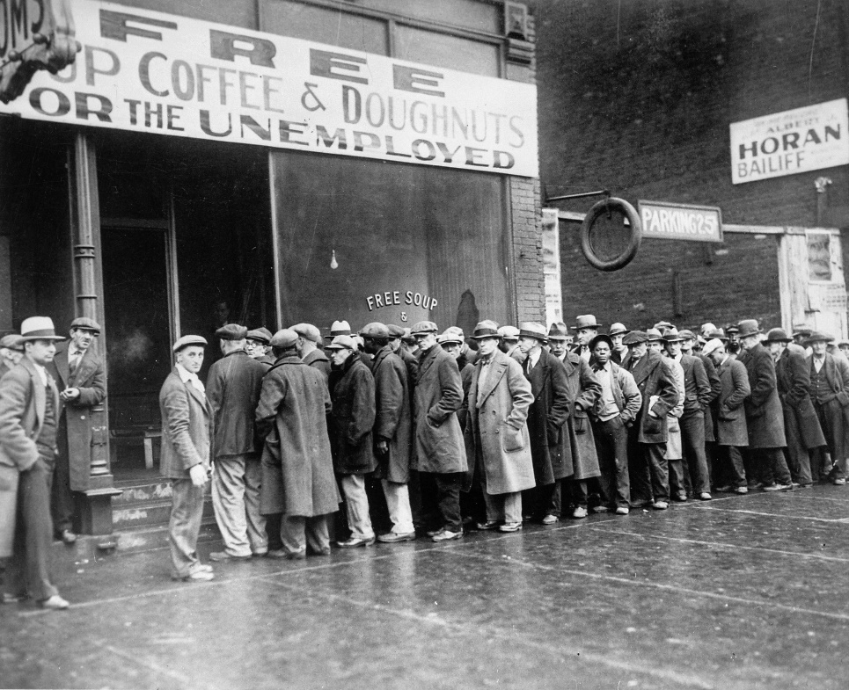
What are some major events influencing federalism?

Slide 5
I. Relationship between the States and Federal Government
D. Federal Grant program development: Fiscal Federalism
Morrill Land Grant/ land division
Federal income tax: means more money
Progressive era and the Great Depression
1964 Civil rights act/ LBJ’s great society
Block Grants/ 1980’s- Regan
South Dakota v. dole
Other ex.- Americans with disabilities act, clean air act, family and medical leave act
1990’s- Devolutions, welfare reform, clinton

Slide 6
Why is the 14th Amendment one of the most important?

Slide 7
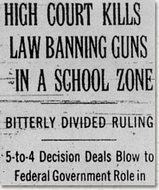
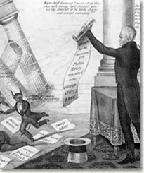
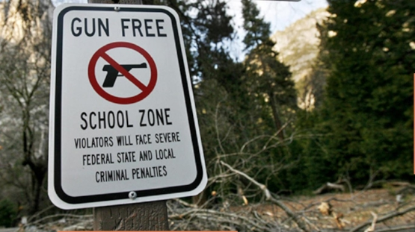
What do these have to do with each other?

Slide 8
II. Constitutional Interpretations of Federalism
Explain how the appropriate balance of power between national and state governments has been interpreted differently over time.
A. Constitutional definition
Federal power: Enumerated powers, Necessary and proper clause/ elastic clause
State power: 10th Amendment, 14th Amendment Equal Protection clause!!!!!!
B. The Supreme court and federalism
McCulloch V. Maryland
United States V. Lopes
C. Growing national powers, Why?

Slide 9
III. Federalism in Action
Explain how the distribution of power among three federal branches and between national and state governments impacts policy making.
A. Sharing powers
B. Political participation and policy making
C. Shared policy making

Slide 10
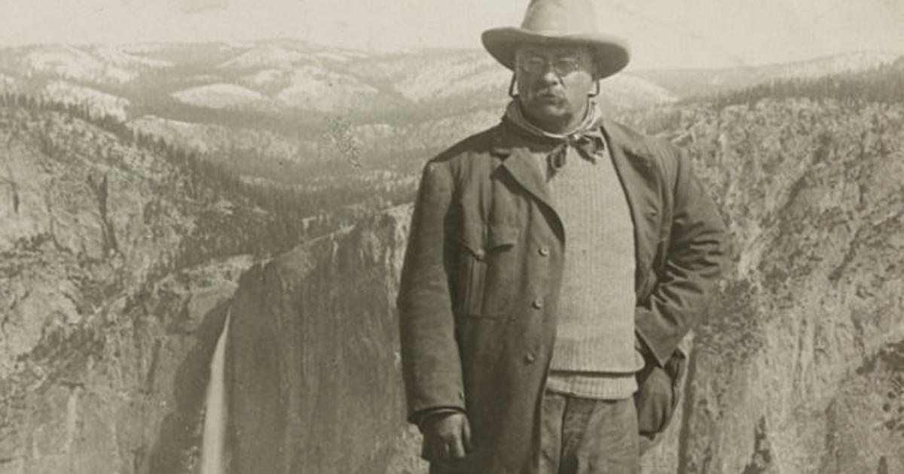

Slide 11
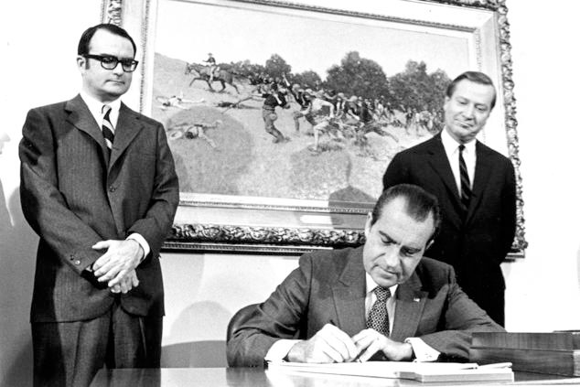
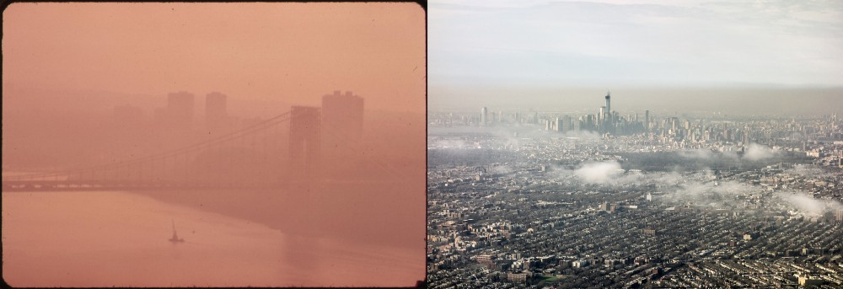
How does this lead to this?

Slide 12
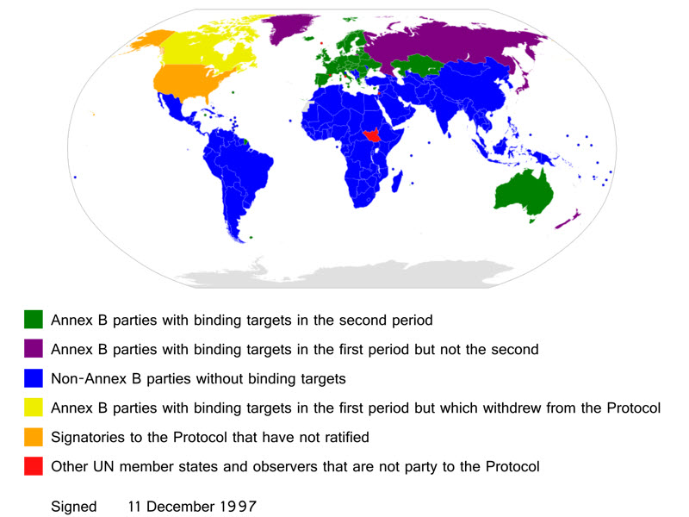
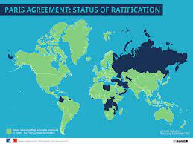

Slide 13
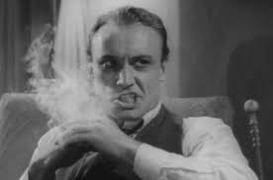
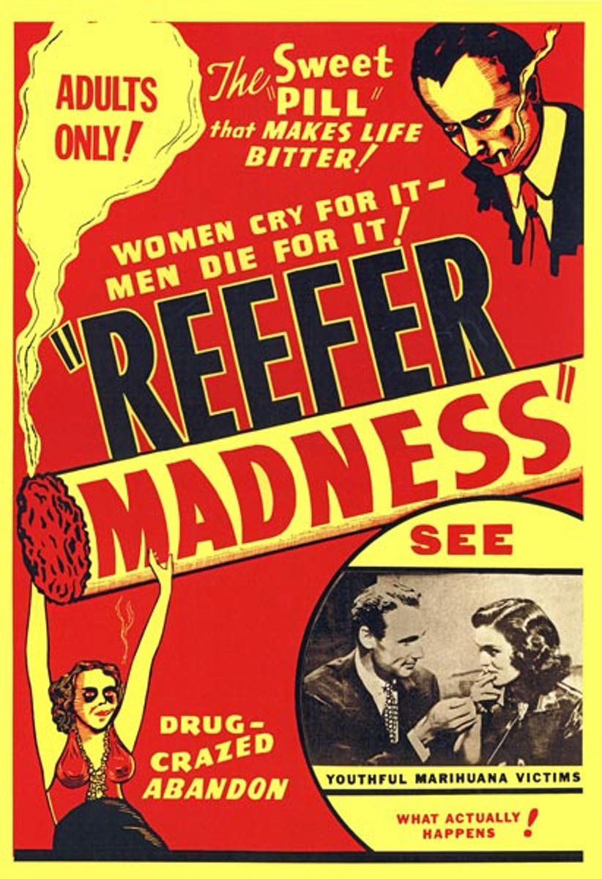
How does this change American laws?

Slide 14
How does this become a thing?

