Slide 1
Reconstruction
1865-1877

Slide 2
Overview of principal Reconstruction laws, proposals and plans:
* 1864-65: Lincoln’s 10% plan
* 1865: 13th Amendment
* 1865-66: Presidential Reconstruction—Johnson’s version of Lincoln’s proposal
* 1866-67: Congressional plan—10% plan with 14th Amendment
* 1867-77: Military Reconstruction (Congress): 14th Amendment plus black suffrage that was later established nationwide by the 15th Amendment.
* Compromise of 1877: ended Reconstruction

Slide 3
I. 4 big questions about reconstruction
How to rebuild the South after its destruction during the Civil War?
B. What would be the condition of African Americans in the South?
C. How would the South be reintegrated into the Union?
D. Who would control the process of Reconstruction: the Southern states, the president, or Congress?

Slide 4
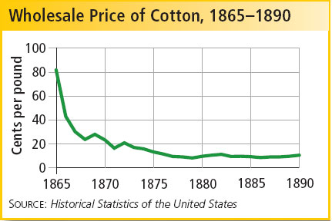
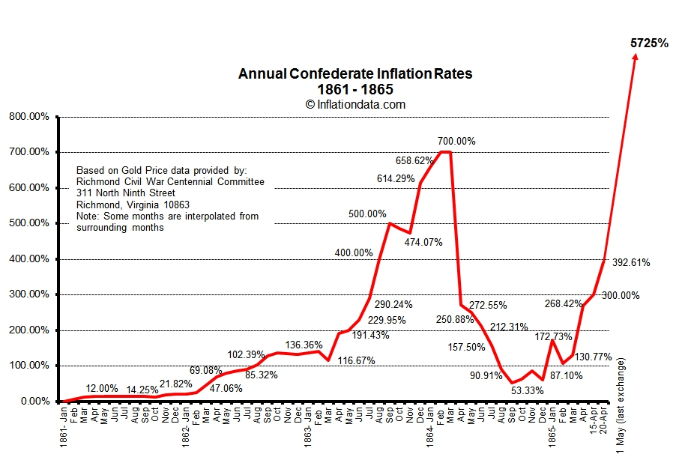
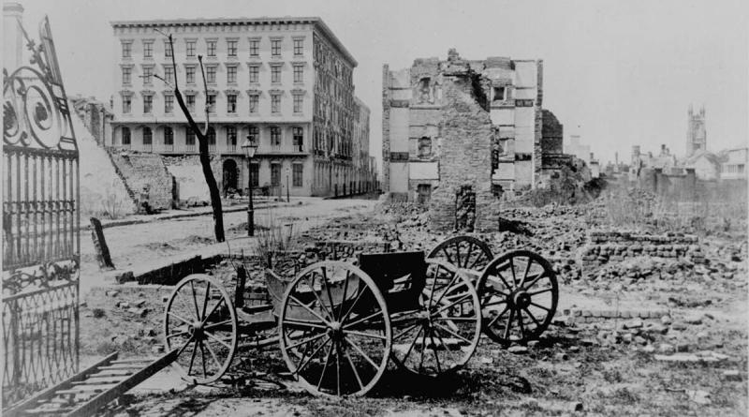
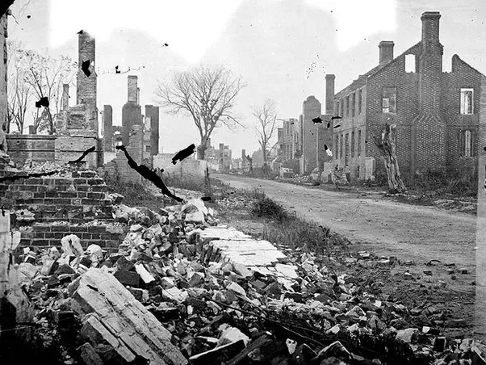

Slide 5
II. The South needed to be rebuilt after the war
Richmond, Charleston, and Atlanta were destroyed
B. Economically the South lay in ruins. 1. Banks were ruined by runaway inflation. 2. Factories were closed or destroyed. 3. The transportation system was devastated.
C. Agriculture 1. Cotton fields lay uncultivated. 2. Livestock was gone after the Union invasion. 3. Agricultural output did not return to the 1860 level until 1870; much was from the new Southwest.
D. Planter aristocrats were also devastated. 1. Their value in slaves simply disappeared with Emancipation. 2. Many mansions were destroyed or ruined.

Slide 6
What is the problem?

Slide 7
III. African Americans in the immediate post-Civil War South
Thirteenth Amendment (ratified in December, 1865)
Freedmen’s Bureau (created in 1865 by Congress)
Headed by General Oliver O. Howard
Purpose: Help unskilled, uneducated, poverty-stricken ex-slaves to survive
provided food, clothing, medicine and education
"40 acres and a mule"
Southern violence was significant
Expired 1872

Slide 8
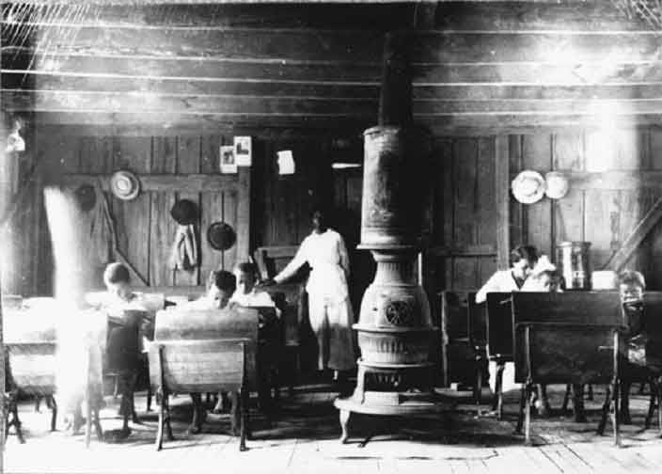

Slide 9
IV. Presidential Reconstruction
President Lincoln: 10% plan
Wade-Davis bill 1864: 50% plan, harsher, vetoed
President Andrew Johnson: southerner, sided with the north, VP
10%, amnesty and pardons, republicans angry
65-66, confederates in office, massacres and violence, KKK
Why did southerners so strongly resist?
Black codes:
To guarantee labor supply
Restore system of race relations

Slide 10
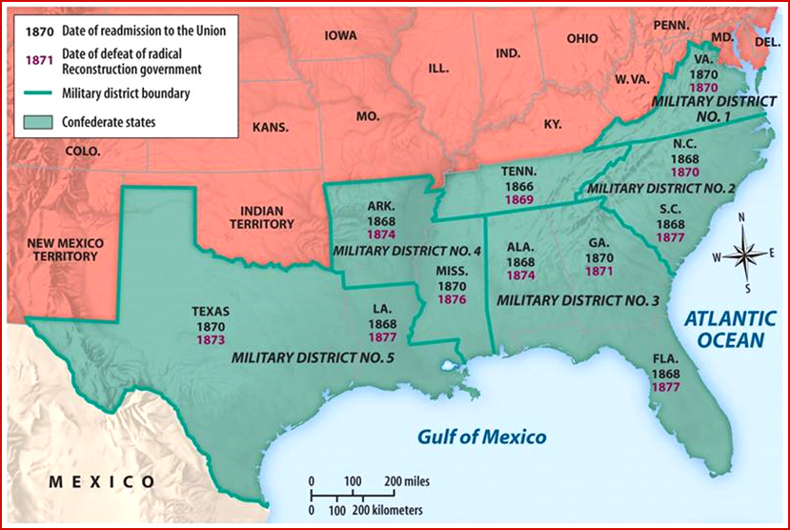
V. Congressional Reconstruction
Congressional backlash- refused entry of southern Democrats
Civil Rights bill of 1866
Fourteenth amendment
Election of 1866: republican super majority 2/3
* Radical republicans: Charles summer, Thaddeus Stevens
Military reconstruction 1867
Impeachment of Johnson
* Tenure of office act, not removed

Slide 11
Guess what this is map of.

Slide 12
V. Congressional Reconstruction
G. Fifteenth amendment 1870: suffrage for black men
F. Temporary gains:
Black representatives: Hiram Revels, Blanche Bruce
G. Republicans in the south: “scalawags” “carpetbaggers”
F. Ku Klux Klan: attempted to overthrow reconstruction, force acts
G. Solid south 1870s: “lost cause”, redeemers
H. Civil Rights act 1875
The end of reconstruction: compromise of 1877,
Rutherford b Hayes

Slide 13
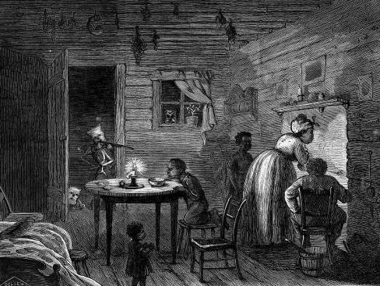
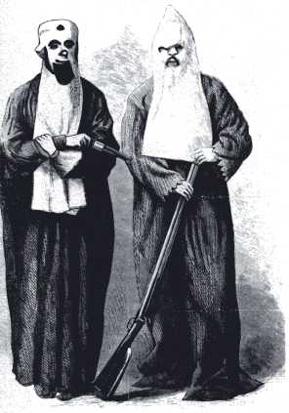
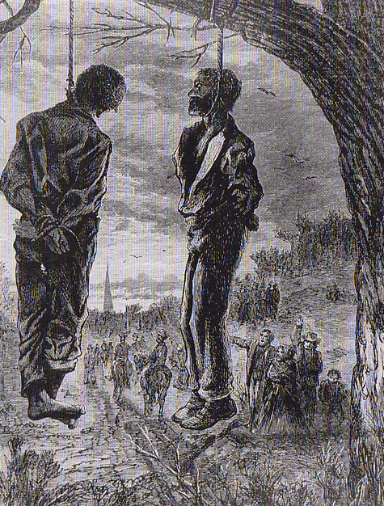

Slide 14
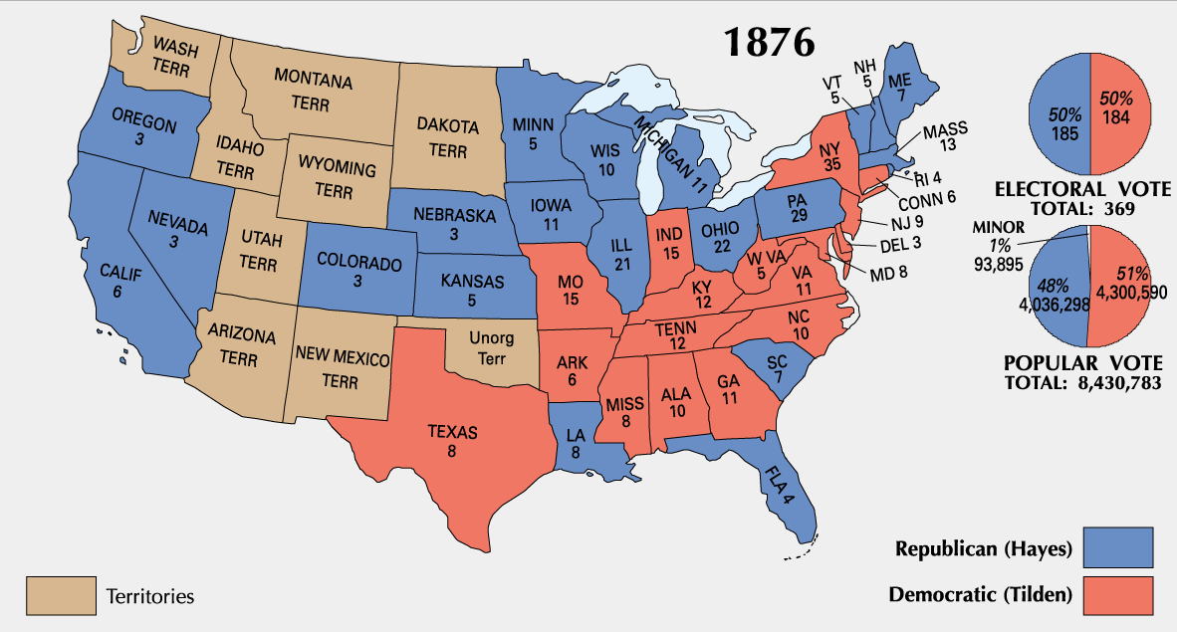

Slide 15
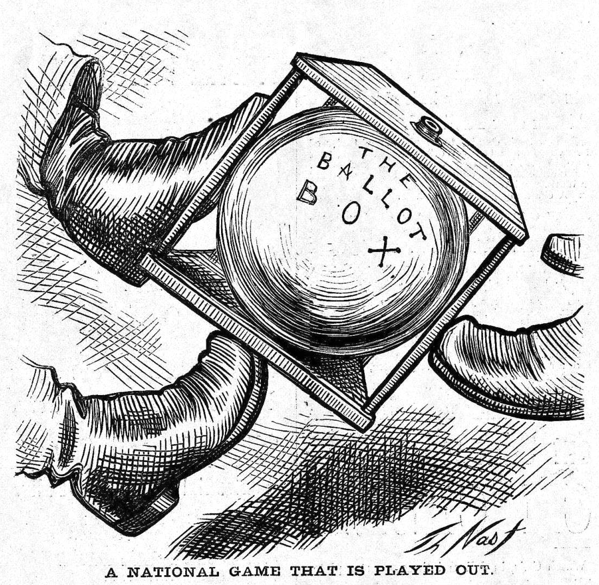
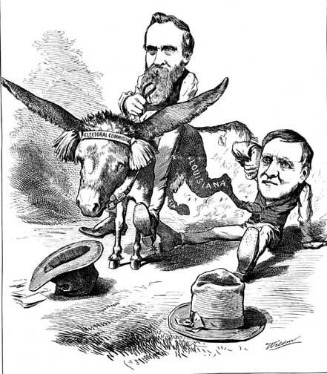

Slide 16
Results of Military Reconstruction
a. The Fourteenth and Fifteenth Amendments to the Constitution were ratified, signifying a watershed in civil rights.
b. Military Reconstruction resulted in a significant decline in presidential power relative to that of Congress.
Subsequent to President Grant, Gilded Age presidents would be weak and faceless while Congress would dominate.
c. Social and economic positives
Property rights for women were guaranteed.
Property requirements were eliminated for holding office.
Steps were taken to establish adequate public schools.
Public works projects were launched, especially in transportation.
Tax systems were improved.
Apportionment was made more equal in state legislatures.
d. Southern Democrats prevailed in taking back control of the South while the Republican party became irrelevant in the region for decades.

Slide 17
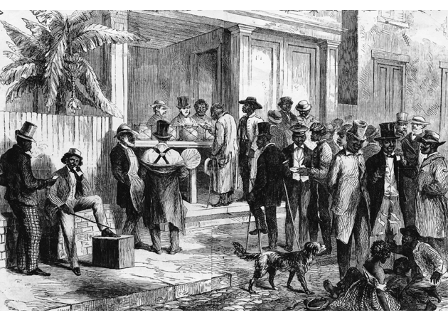
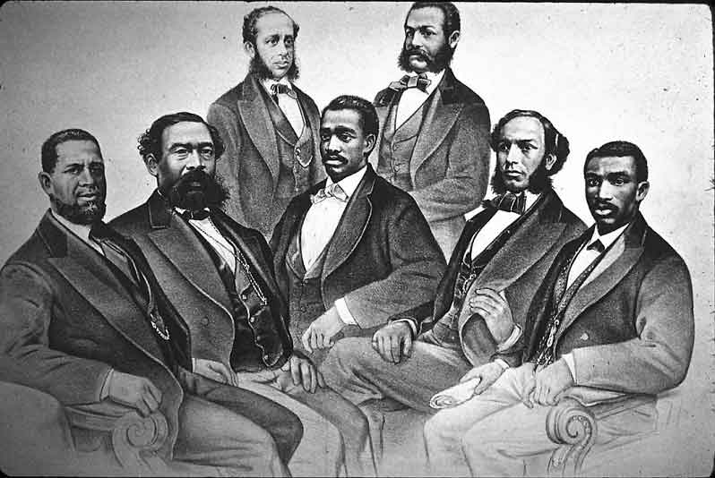

Slide 19
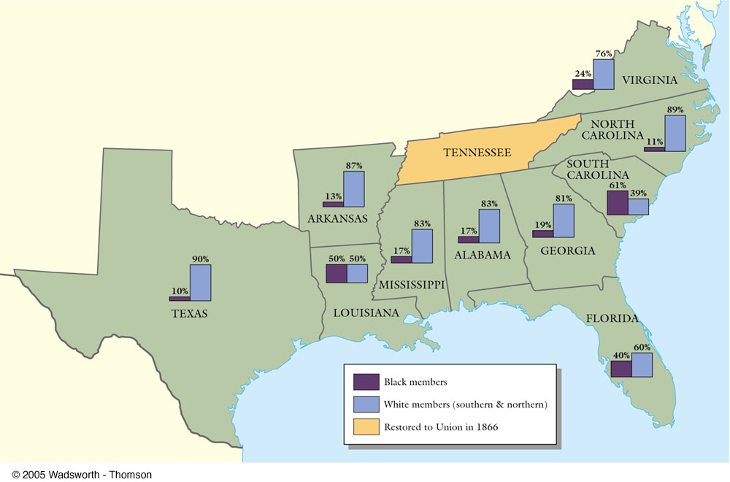

Slide 20
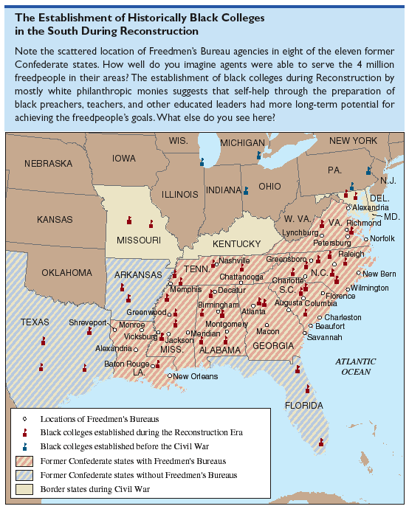

Slide 21
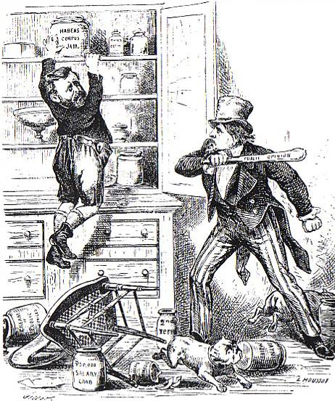
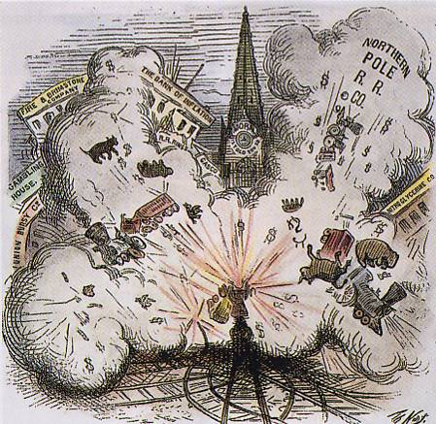

Slide 22
VI. Post-Reconstruction Civil Rights: Road to institutional discrimination
Reconstruction failed to empower African Americans politically.
Sharecropping
Slaughterhouse cases 1873
Civil Rights Cases 1883
Wholesale disenfranchisement began in 1890
* Poll taxes, Literacy tests, “grandfather clause”, gerrymandering, Jim crow laws
Lynching's: 200 per year, IDA b. Wells-Barnett
Booker T. Washington and education for African Americans
* Tuskegee institute, accommodation, “Atlanta compromise” speech

